Slide 1


BUSINESS MEETING SUMMARY GENERATION Unlock the hidden potential of your meetings
Team – 7
Under the Guidance of
Dr.K.Sai Prasad
Associate Professor
HOD CSE-(AIML)
A.Dheeraj Reddy - 20R21A6602
A.Chinmaye - 20R21A6601
D.Saketh Reddy - 20R21A6614
Md Irfan - 20R21A6638

Slide 2

INTRODUCTION
Meetings share a lot of information, making it hard to retain key insights.
Professionals find it challenging to capture and remember key insights from lengthy meetings.
Business meetings are often long, making it hard to catch all the important details.
Traditional note-taking methods don't work well in these situations.

Slide 3
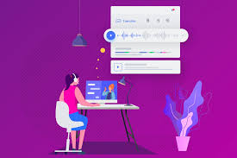
OBJECTIVES
Creating a user-friendly application.
Generate concise summaries to save time for the busy people.
Identify and highlight key insights from the meeting discussions.
Generate the main Themes of the audio file

Slide 4




SWOT Analysis
S
W
O
T
Strengths:
Weaknesses:
Opportunities:
Threats:
Efficiency
Accuracy
Consistency
Customization
Ambiguity Handling
Dependency on Data Quality
Lack of Context Understanding
Integration with Collaboration Tools
Continuous Learning
Multilingual Support
Real-time Summarization
Privacy Concerns
Security Risks
Algorithmic Bias

Slide 5
ARCHITECTURE

Slide 6


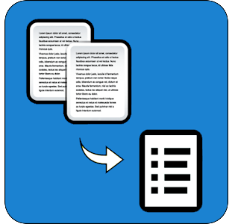






Audio file
Audio to text
Extractive transcript
Abstractive transcript
UI
Evaluation
Summary transcript
Testing

Slide 7
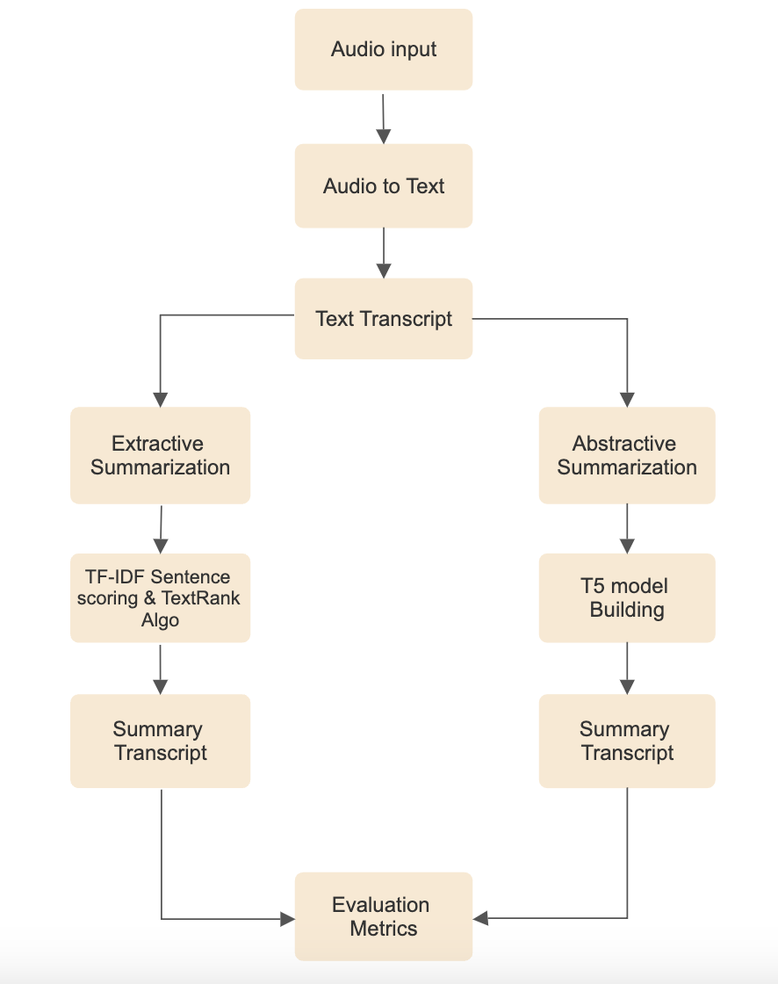

Slide 8
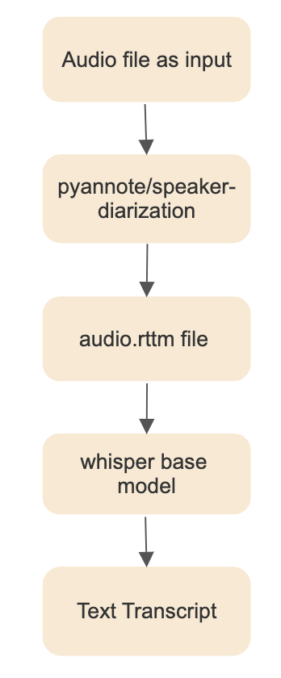
Audio to Text Transcript

Slide 9
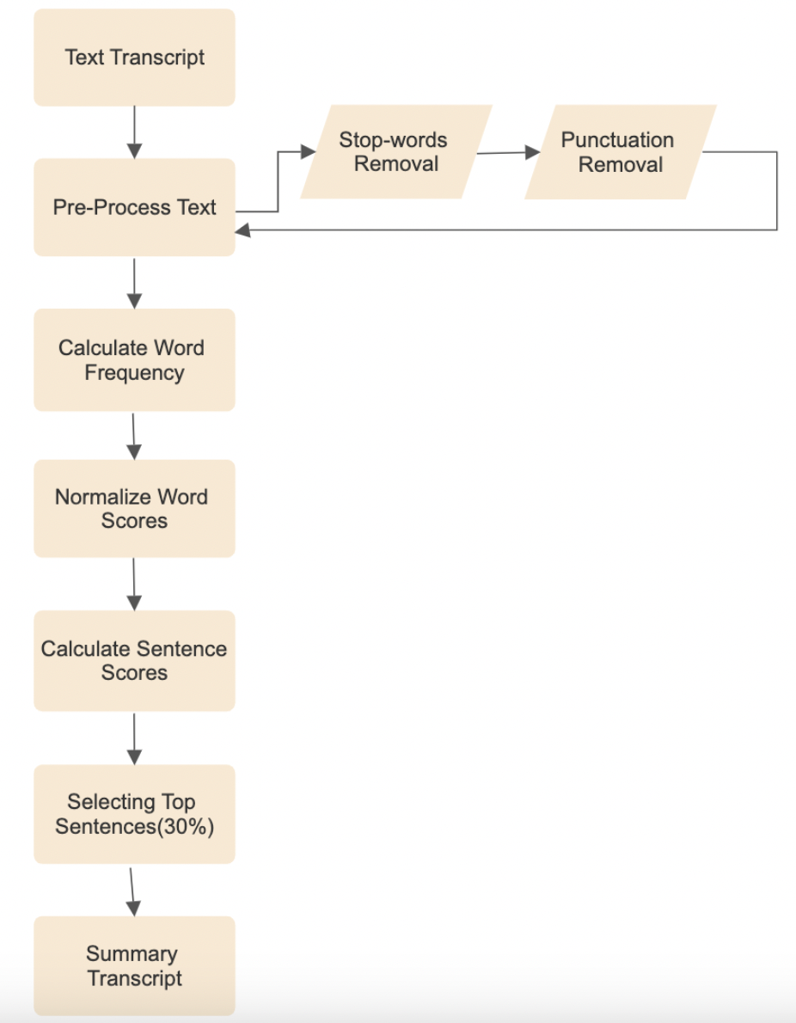
Extractive Summarization

Slide 10
Abstractive Summarization
Taking text transcript as input
Splitting text into chunks
Generating short summary using T5 Model
Generating Theme of the meeting using Fine-tuned trained model of
simpleT5

Slide 11
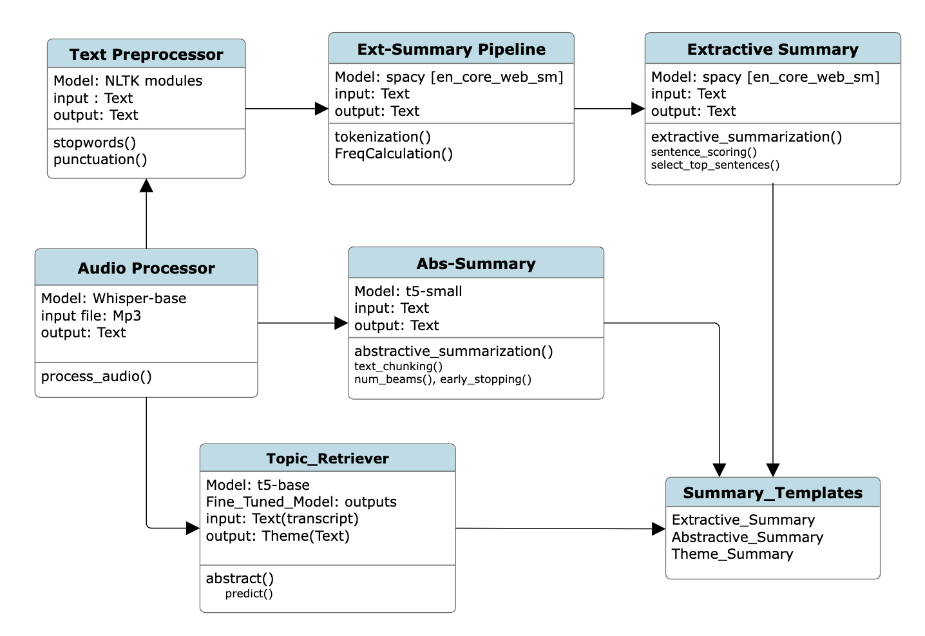
UML Diagram

Slide 12
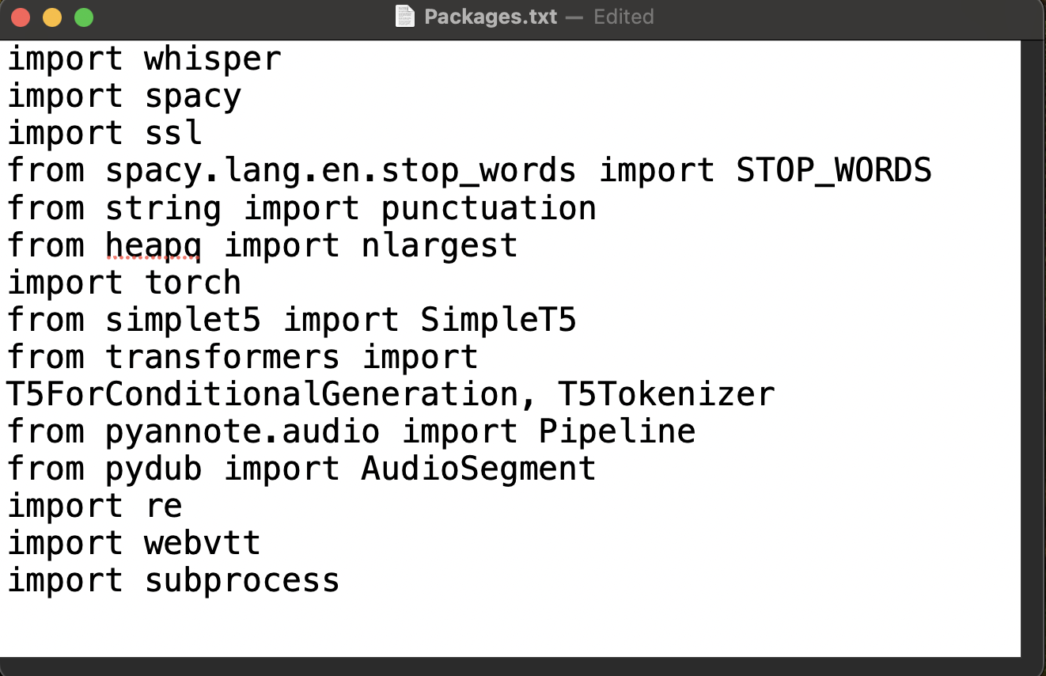
Packages

Slide 13
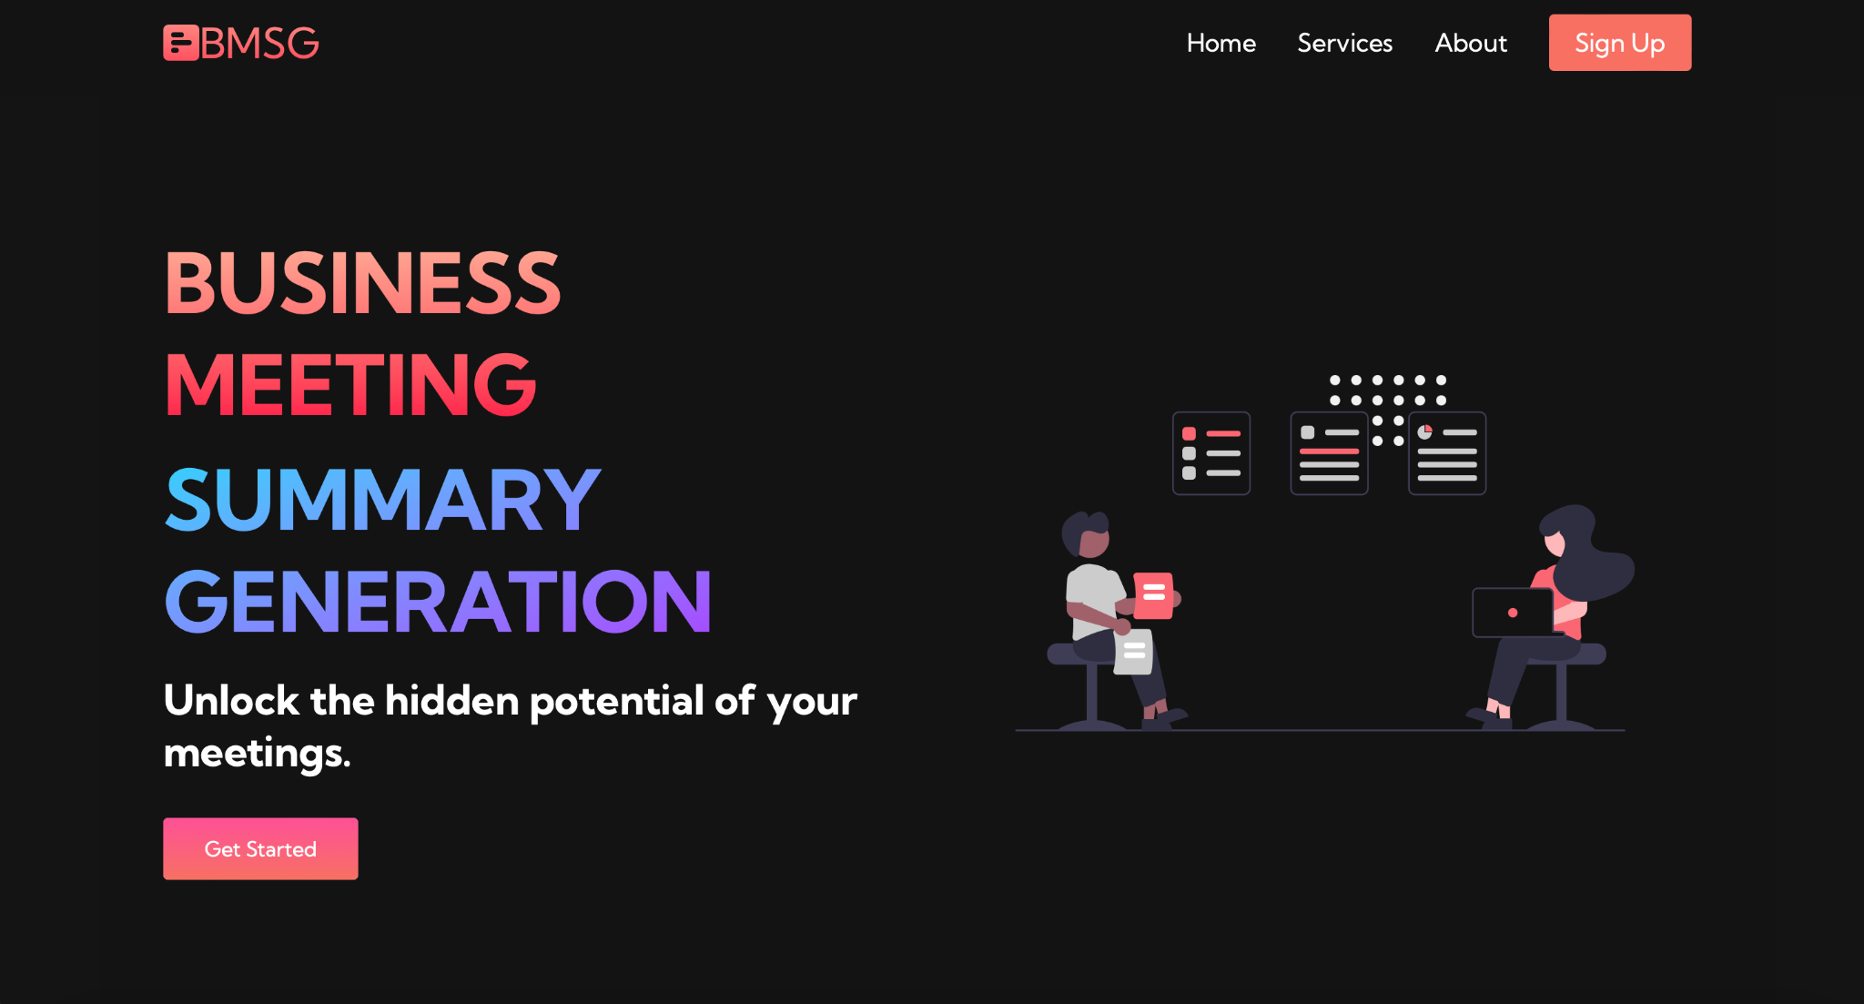
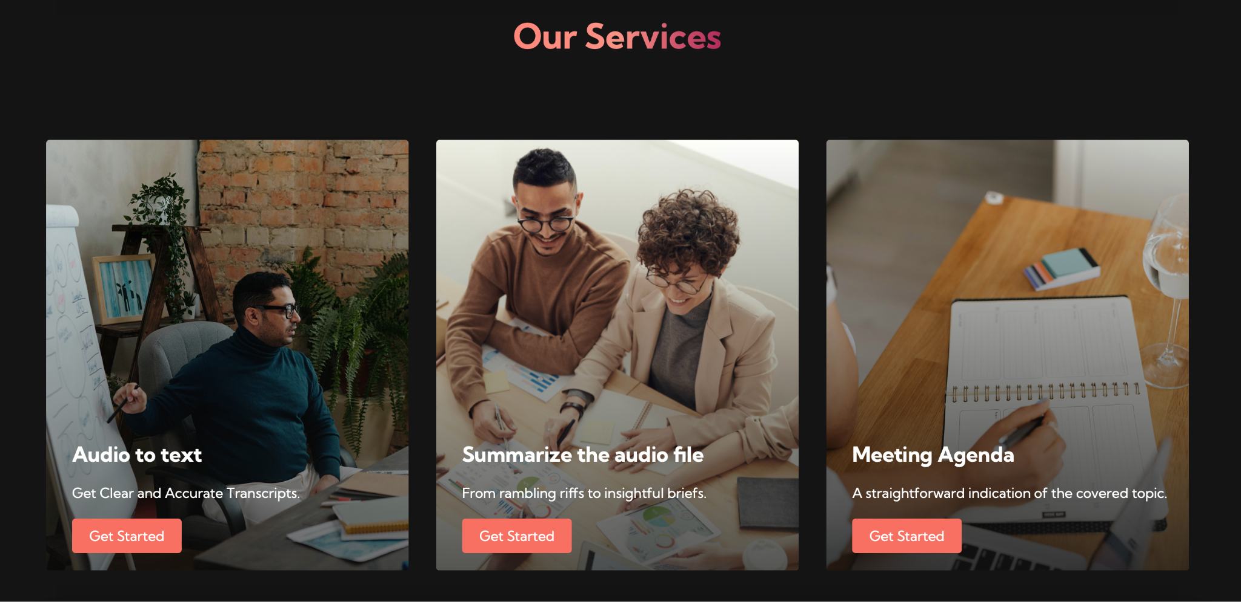
Project UI

Slide 14
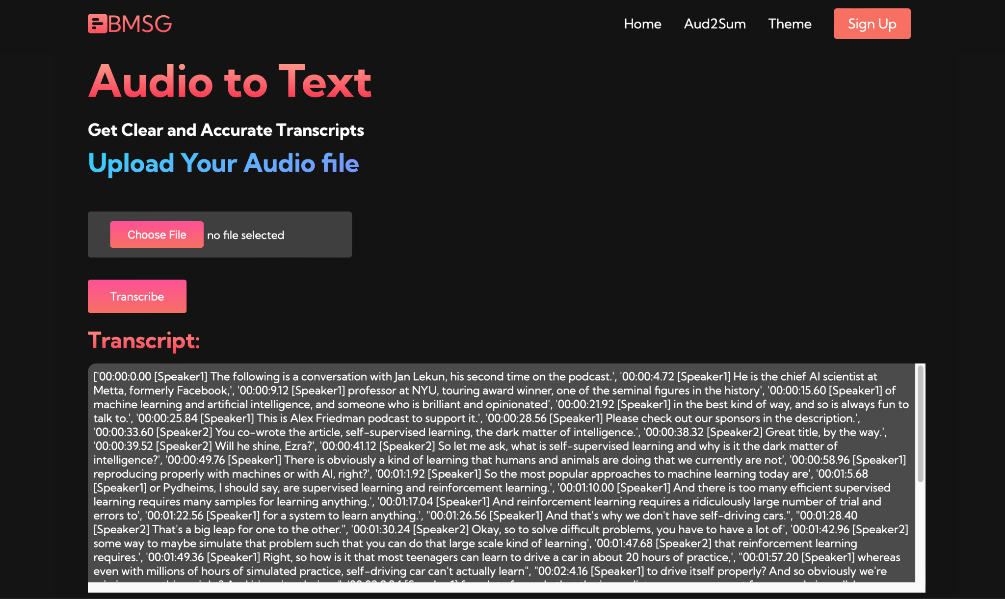
Service-1 Audio to Text
Implemented Using Pyannote & Whisper
Given an input file of mp3 or wav the text is
displayed on the screen

Slide 15
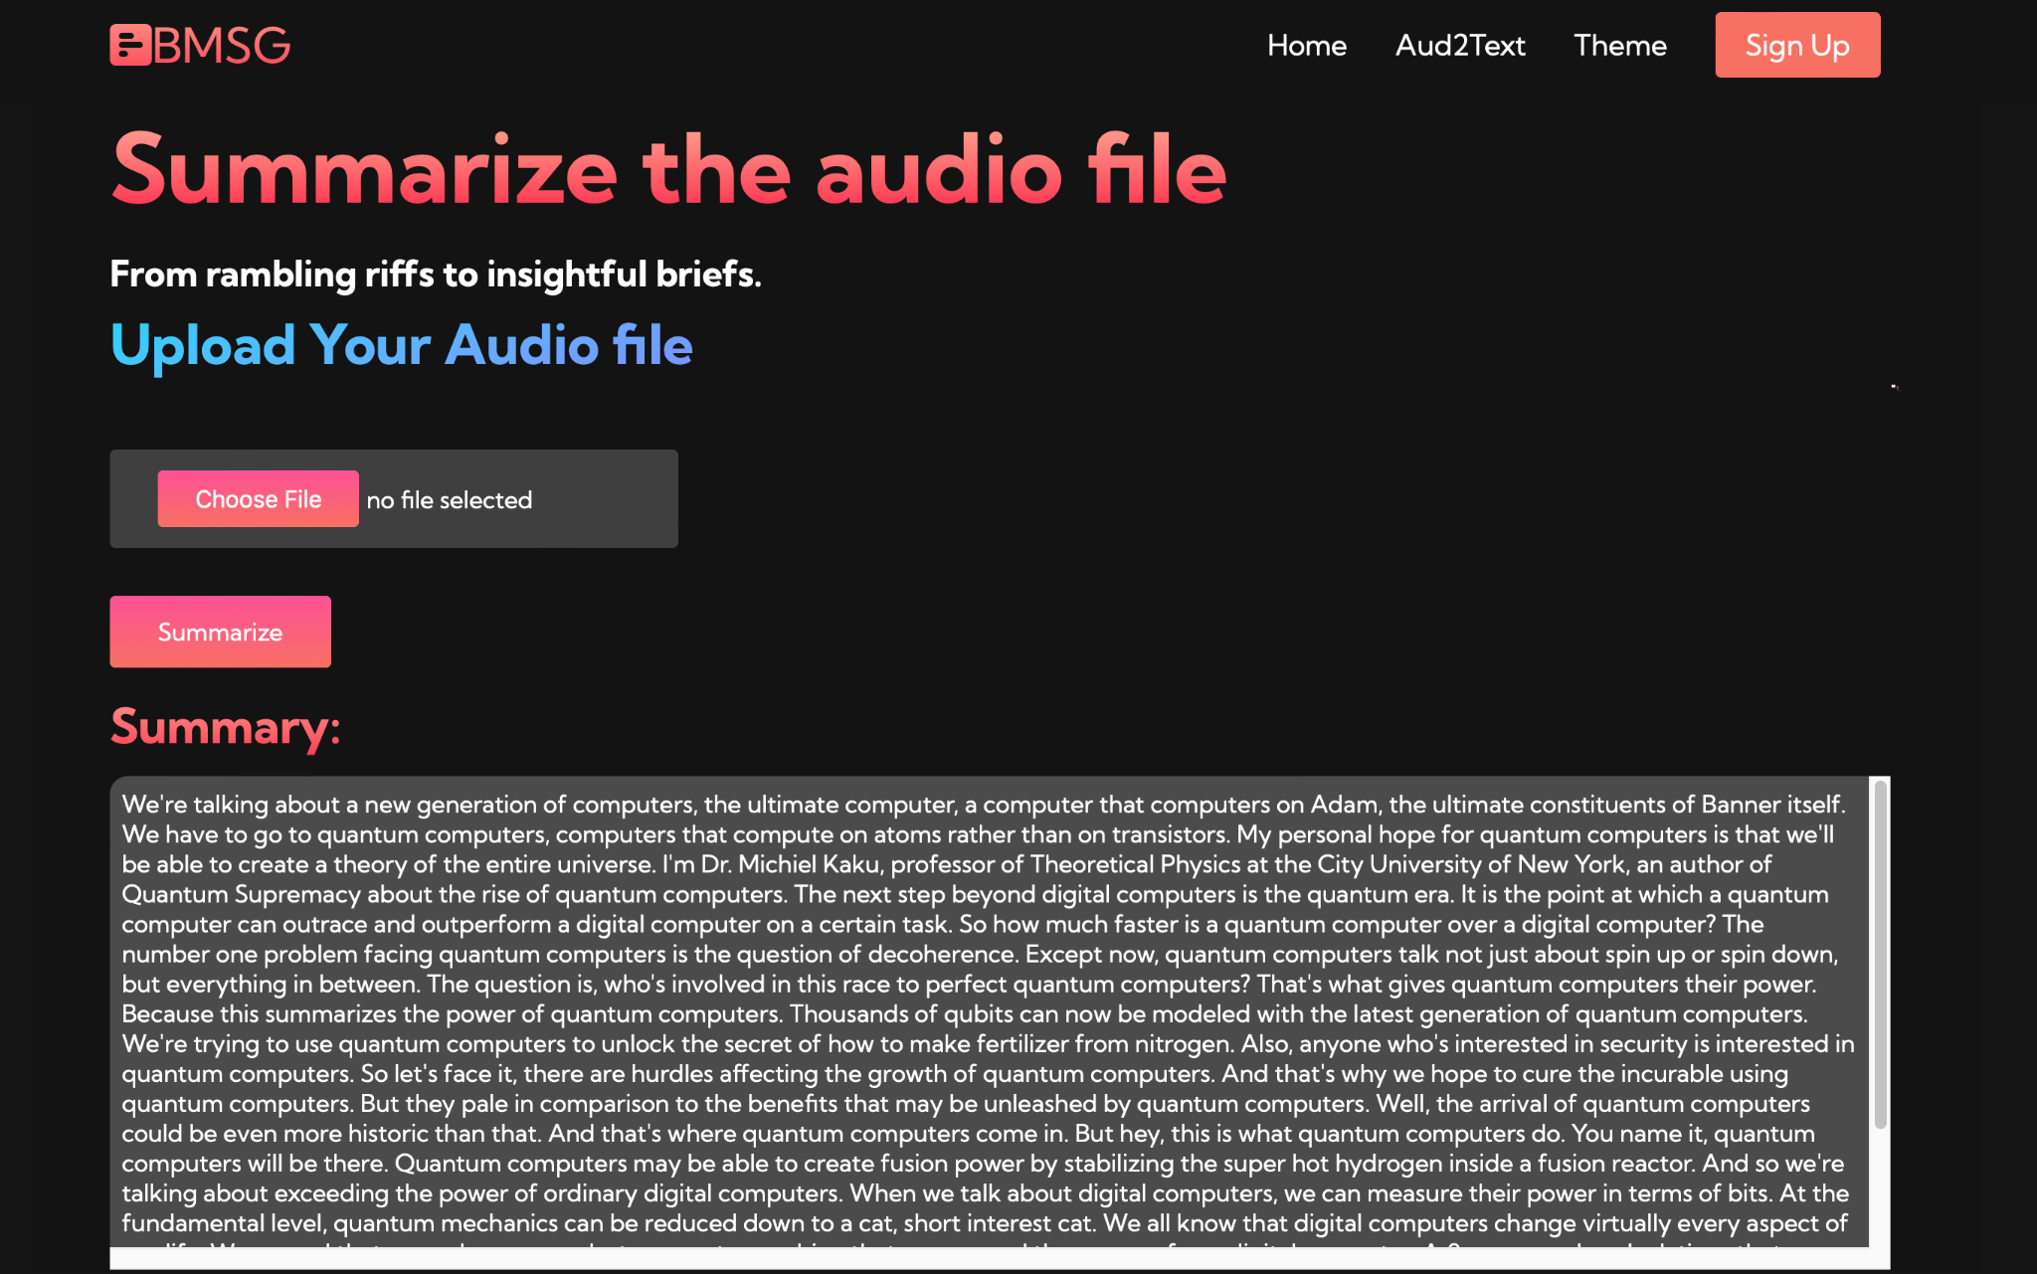
Service-2 Summary Generation
Using Spacy en_core_web_sm model
Top 30% sentences are given as per
the sentence scoring using TF-IDF
method.

Slide 16
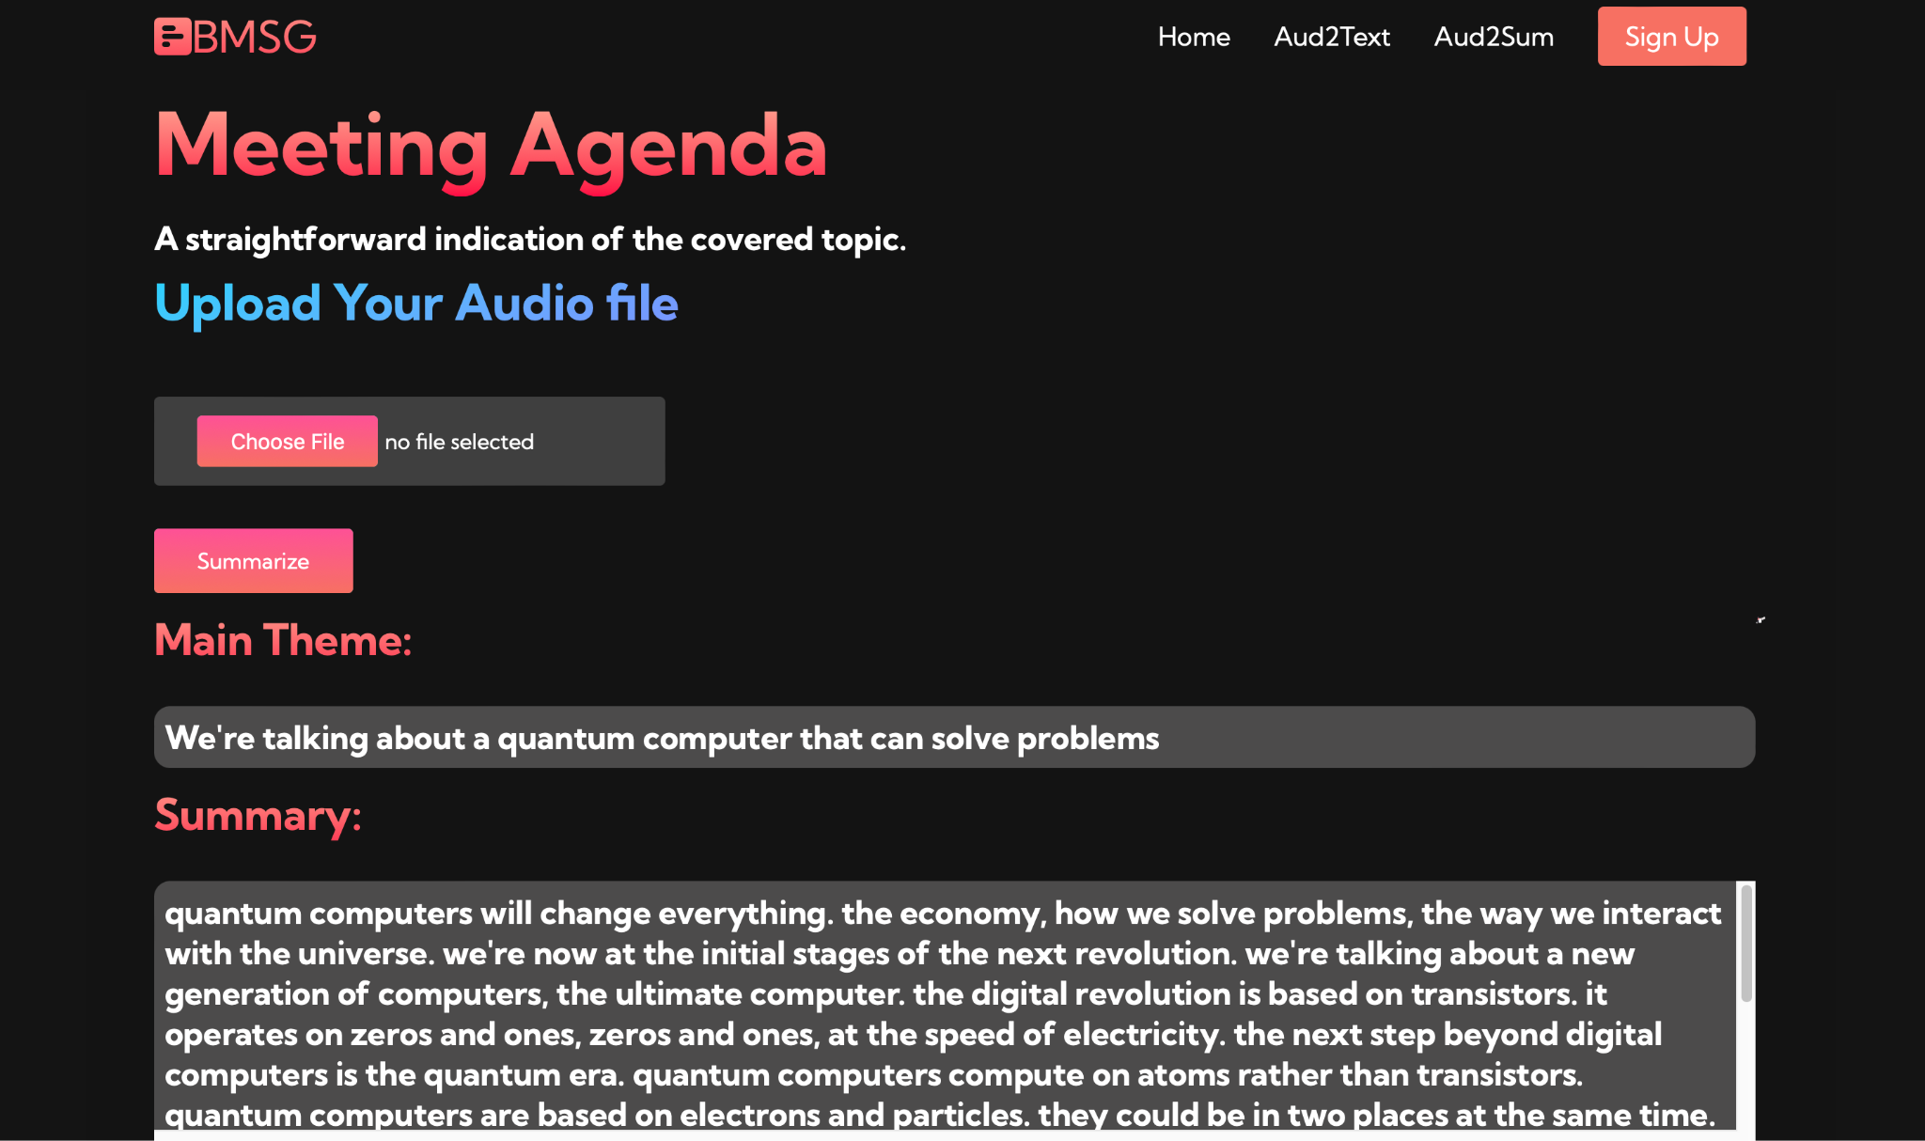
Service-3 Theme Generator
t5-small model fine-tuned on amazon
food reviews & news summary dataset.
Summary Generated is of new sentences

Slide 17
Conclusion & Future Scope
NLP in the field of Meeting Summarizer has a huge scope.
Businesses needs to embrace this technology in order to stay competitive, using this tech the possibilities are endless.
Multi-modal Summarization and real time summarization with customization & personalization could be some of the features that could be worked on in the near future.

Slide 18

THANK YOU!!

